Slide 1
Course - DT228-2
Module (Subject) -
Human Computer Interaction
Semester 2, Week 3
ATTENTION AND MEMORY
(of the User)

Slide 2
Overview of Lecture
A discussion of 2 cognitive mental processes
Perception
Attention
Memory
Learning

Slide 3
Cognitive Processes (Again)
The variety of cognitive attributes have an important influence on screen design.

Slide 4

Recap… Cognition
Cognition is the processing of information.
It includes:
Perception
Attention
Pattern Matching
Memory
Language Processing
Decision Making
Problem Solving

Slide 5
Recap… Gestalt laws (Principles) of perceptual organisation
Proximity - dots appear as groups rather than a random cluster of elements
Similarity - tendency for elements of same shape or colour to be seen as belonging together
Closure - missing parts of the figure are filled in to complete it, so that it appears as a whole circle
Continuity - the stimulus appears to be made of two lines of dots, traversing each other, rather than a random set of dots
Symmetry - regions bounded by symmetrical borders tend to perceived as coherent figures

Slide 6
Cognitive Processes - Attention
Human Considerations

Slide 7
Cognitive Processes – Attention (2)
Attention
Basic Forms
Of Attention
Multi-tasking
Automatic
Processing
Techniques to
Guide Attention
Human Considerations

Slide 8
A Simplified View of Human Information Processing (HIP)
A simplified model of Human Information Processing (HIP),
including memories and processor.

Slide 9
Memory Aids
Memory Aids
Heuristics: rules of thumb that depend heavily on the content and context of the task.
Metaphor: a cognitive process in which an experience is related to an already familiar concept.
Mental model: a representation of the conceptual structure of a device or a system.
Human Considerations

Slide 10
Cognitive Processes – Attention (3)
The human brain is constantly being bombarded with stimuli and information.
How can we make sense out of this information and not to suffer from information overload?
The manner in which we deploy our attention has a tremendous effect on how effectively we interact with a system.
Human Considerations

Slide 11
Understanding Users – What goes on in the Mind?
Cognitive processes
Attention
What we're focussing on at the moment
Goal: searching for something in particular
Goal: browsing for something that looks interesting
Divided attention
allows us to handle multiple stimuli
makes it difficult to handle all the information
Information presentation
perceptual boundaries (borders)
colour
sound
flashing lights
in moderation!

Slide 12
Cognitive Processes – Attention (4)
Basic Forms of Attention
Our ability to attend to one event out of a mass of stimuli is known as focused attention.
We are also capable of divided attention, e.g. driving while holding a conversation.
Attention may also be voluntary (we make a conscious effort to change our attention) or involuntary (a stimuli suddenly grabs our attention).
Human Considerations
Notes:
Stimuli
Definition: a thing or event that evokes a specific functional reaction in an organ or tissue.
"areas of the brain which respond to auditory stimuli“
Or
something that incites to action or exertion or quickens action, feeling, thought, etc.

Slide 13

Cognitive Processes – Attention (5)
Human Considerations

Slide 14
Cognitive Processes – Attention (6)
In the context of HCI, we must ask questions such as:
If users are distracted, how is it possible to get their attention again without them having to spend time figuring out what they were doing?
How can we focus users attention on what they need to be looking at for any given stage of a task?
How can we guide their attention to the relevant information on a display?
Human Considerations

Slide 15
Cognitive Processes – Attention (7)
How do you think that a user can be more focused?
One of the most important ways to help focus users attention to the information they need is to structure the interface so that it is easy to navigate through.
Also, the perceptual laws of grouping should be used so that information can easily be perceived.
Human Considerations

Slide 16
Cognitive Processes – Attention (8)
The following slide contains an example screen from a hotel information system.
Answer the following questions from the example screen:
What is the phone number of the Days Inn in Charleston?
Name the hotel that offers a double room for $33?
Human Considerations

Slide 17
Room
City Hotel Phone Single Double
Charleston Best Western 575-3454 $23 $39
Charleston Days Inn 878-3423 $20 $34
Charleston Holiday Inn 234-4623 $36 $46
Charleston Howard Johns 342-5728 $33 $47
Charleston Ramada Inn 387-4523 $18 $28
Charleston Sheraton Inn 764-5879 $40 $80
Charleston Marda Hotel 476-5876 $26 $38
Columbia Best Western 422-7567 $32 $50
Columbia Carolina Inn 336-8711 $20 $25
Columbia Holiday Inn 761-4765 $22 $33
Columbia Howard Johns 487-8232 $34 $40
Columbia Quality Inn 471-4762 $20 $35
Columbia Ramada Inn 479-9897 $33 $47

Slide 18
Cognitive Processes – Attention (9)
The following slide contains an example screen from a different hotel information system.
Again, answer the following questions from the example screen:
What is the phone number of the Holiday House?
Name the hotel that offers a double room for $27?
Human Considerations

Slide 19
Pennsylvania
Bedford Motel/Hotel: Crinoline Courts
342-4657 S:$18 D:$28
Bedford Motel/Hotel: Holiday Inn
465-3865 S:$29 D:$36
Bedford Motel/Hotel: Midway
763-8623 S:$21 D:$26
Bedford Motel/Hotel:Penn Manor
654-9987 S:$18 D:$25
Bedford Motel/Hotel: Quality Inn
764-8766 S:$22 D:$29
Bradley Motel/Hotel: Holiday House
777-9898 S:$28 D:$24
Bradley Motel/Hotel: De Soto
7798-9836 S:$22 D:$25
Bradley Motel/Hotel: Holiday Inn
733-9851 S:$32 D:$27
Breezewood Motel/Hotel : Western Plaza
837-9373 S:$28 D:$29

Slide 20
Cognitive Processes – Attention (10)
In this example, the way information is structured at the interface has a major impact on our ability to find and attend to information.
In the original study, (Tullis 1984) average search times for a single item were 3.2 seconds for the first screen and 5.5 seconds for the second.
In the first screen, information is easier to find:
similar information has been grouped into categories
spacing is employed to facilitate the perceptual process
Human Considerations

Slide 21
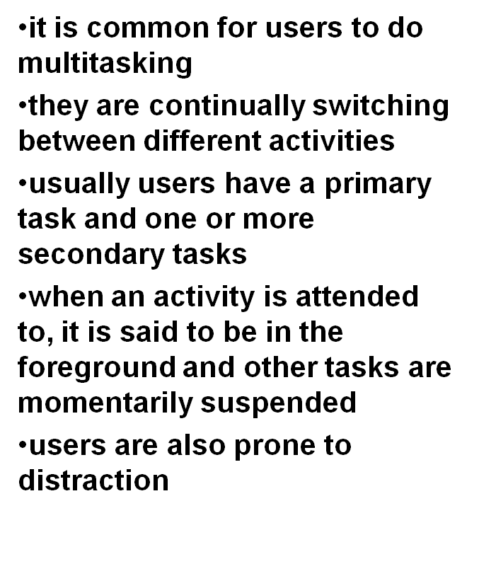
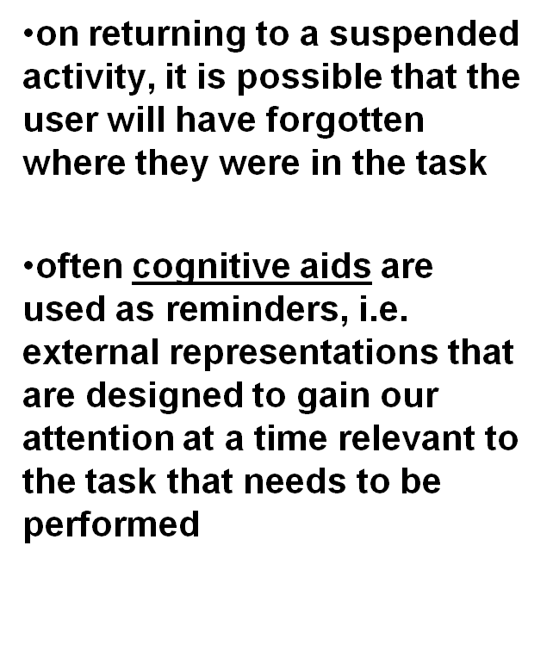
Cognitive Processes – Attention (11)
Multitasking
Human Considerations

Slide 22
Cognitive Processes – Attention (12)
Automatic Processing
Many activities that we carry out regularly become automated, we do them without really thinking about them.
Cognitive processes can also become automatic with practice.
Automatic cognitive processes are identified as
fast
demanding minimal attention, so do not interfere with other activities
Being ‘unavailable to consciousness’
Human Considerations

Slide 23
Cognitive Processes – Attention (13)
The classic example used to demonstrate the phenomenon of automatic cognitive processing is the Stroop Effect.
Human Considerations

Slide 24
Stroop’s Experiments (Task 1 and 2) Task 1: Read Words Task 2: Name Colours
In the original Stroop effect experiment (Stroop, 1935), stimuli were presented which contained either a single or several dimensions.
In this case, either colour words (“blue”, “red”, etc.) were presented in black ink or they were presented in various coloured inks.
In Experiment 1, the participants were to read the words. When asked to read the words, the incongruent list took slightly longer (41 seconds vs. 43.3 s).
In Experiment 2, participants were asked to name the colour of the ink. The stimuli were changed slightly to create a slightly different control condition. In this task, the incongruent list took much longer to go through than the control list (110.3 s vs. 63.3 s).
Notes:
In the original Stroop effect experiment (Stroop, 1935), stimuli were presented which contained either a single or several dimensions. In this case, either colour words (“blue”, “red”, etc.) were presented in black ink or they were presented in various coloured inks. In Experiment 1, the participants were to read the words. When asked to read the words, the incongruent list took slightly longer (41 s vs. 43.3 s). The stimuli looked like the following:

Slide 25
Stroop’s First Experiment Task: Read Words
CONTROL
Red
Blue
Green
Brow
Purple
INCONGRUENT
Red
Blue
Green
Brown
Purple
Notes:
In Experiment 2, participants were asked to name the colour of the ink. The stimuli were changed slightly to create a slightly different control condition. In this task, the incongruent list took much longer to go through than the control list (110.3 s vs. 63.3 s).

Slide 26
Stroop’s First Experiment Task: Name colours
CONTROL
INCONGRUENT
Red
Blue
Green
Brown
Purple
Notes:
In Experiment 2, participants were asked to name the colour of the ink. The stimuli were changed slightly to create a slightly different control condition. In this task, the incongruent list took much longer to go through than the control list (110.3 s vs. 63.3 s).

Slide 27
XHFG
EJHFU
EEF
KJBVN
DJEBSI
DJVBY
DKSNVL
SKHJSHE
FJJVN
EIJHFH
KSNNC
DSKA
KD
VNNVJR
EFJJIE
VKJNDS
EOEUJ
DJNVK
SSXZ
DJSD
DFJJNV
EIUGHBV

Slide 28
RED
YELLOW
BLUE
BLACK
GREEN
YELLOW
BLACK
RED
BLUE
GREEN
RED
GREEN
YELLOW
BLACK
GREEN
YELLOW
BLUE
RED
YELLOW
BLUE
GREEN
BLACK

Slide 29
Cognitive Processes – Attention (14)
It should have taken longer to say the colour names in the second list.
This is because in the second list there is a conflict between the automatic process of reading the words and the automatic process of perceiving the colours.
The difference between automatic and non-automatic cognitive processes:
Automatic processes are not affected by the limited capacity of the brain.
They require little attention and are extremely difficult to unlearn.
Human Considerations

Slide 30
Cognitive Processes – Attention (15)
Implications for HCI Design
Consider a user who has learned a set of keyboard combinations for a particular word processor to the extent that they have become automatic processes.
If key combos have been changed -> major effort for the user to unlearn their automatic processes.
That leads to much frustration on the part of the user.
The change could be dangerous, potentially, in critical applications such as process control plants.
Human Considerations

Slide 31
Cognitive Processes – Attention (16)
In using the various methods, it should be remembered that:
important information should always be displayed in a prominent place to catch the users eye.
less urgent information should be allocated to less prominent but specific areas of the screen so that the user will know where to look when this information is required.
information that is not needed very often should not be displayed but should be made available on request.
Human Considerations

Slide 32
Cognitive Processes - Memory
Attention
Human Considerations

Slide 33
Cognitive Processes – Memory (2)
Memory
Categories
Of Memory
Levels of
Processing Theory
Recognition
Vs. Recall
Techniques to
Guide Memory
Human Considerations

Slide 34
Cognitive Processes – Memory (3)
Say aloud the numbers, 1, 7, 4, 2, 8.
Next, repeat them Short-Term Memory
1, 7, 4, 2, 8
What were the 4 user groups discussed in last week’s lecture?
Skills and Knowledge, Disabilities, Age and Cultural Long-Term Memory
Human Considerations

Slide 35
Cognitive Processes – Memory (4)
Memory is involved in all our cognitive tasks and has 3 major components:
Sensory memory –
‘Snapshot' of our environment, stores this information for a short period
Act as buffers for stimuli received through the senses
Holds information for a short time e.g., visual information fades away in less than a second
Short-term memory –
Information of the present
Information retained automatically and retrieved without effort
Amount of information that can be retained is severely limited – Miller’s chunking concept (7 +/- 2)
Long-term memory –
Information of the past
Amount of information that can be retained is unlimited
Human Considerations

Slide 36
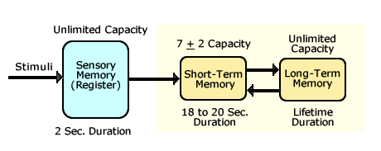
Cognitive Processes – Memory (5)
Capacity and Duration of Memory Components***
***Values for the duration of sensory and short-term memory will vary by study & researcher
Human Considerations

Slide 37








Cognitive Processes – Memory (6)
Short-Term Memory
Do you remember which of the shapes below were shown?
Human Considerations

Slide 38
Cognitive Processes – Memory (7)
Levels of Processing Theory
The level of processing theory has been developed to try and explain why some material is easily remembered while other material is difficult to remember.
Human Considerations

Slide 39
Cognitive Processes – Memory (8)
The meaningfulness of an item determines the depth at which it is processed.
The main attributes of an item that determines its meaningfulness are.
Level
of
processing
Familiarity
Meaningfulness
Imagery
Human Considerations

Slide 40
Cognitive Processes – Memory (9)
The familiarity of a word or concept refers to the frequency with which it occurs on everyday language:
‘Door’, ‘read’ and ‘stop’ are examples of familiar words while ‘compile’ and ‘scan’ are examples of unfamiliar words
Imagery refers to the ability a word or concept can elicit images in one’s mind:
High imagery words are ‘eat’ and ‘sleep’ while low imagery words are those such as ‘begin’ and ‘evaluate’
Human Considerations

Slide 41
Cognitive Processes – Memory (10)
Implications for Design
Items need to be as meaningful as possible.
What is a meaningful item?
Items should be selected based on how familiar and image-able they are.
This is not as simple as it sounds!
Human Considerations

Slide 42
Comment on the following websites regarding familiarity and imagery...
Human Considerations

Slide 43

Cognitive Processes - Memory
Human Considerations

Slide 44
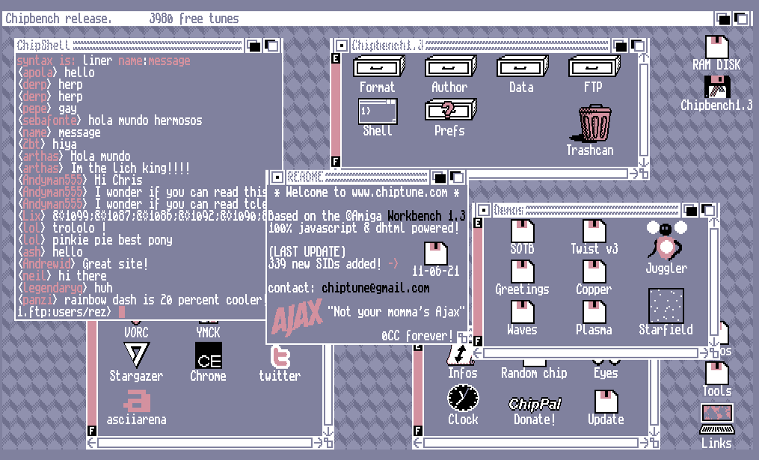
Cognitive Processes - Memory
Human Considerations

Slide 45


Slide 46
Cognitive Processes – Memory (11)
Recognition vs Recall
(‘Knowledge in the World’ vs ‘Knowledge in the Head’)
We can recognise material far better than we can recall it.
Since people are usually bad at remembering what, when and how they have to do something, they will structure their environment to provide the necessary information they require.
People also tend to only remember information that is necessary for them to carry out their everyday tasks.
Human Considerations

Slide 47
Cognitive Processes – Memory (12)
Memory Aids:
To overcome the "bottleneck" of working memory, humans have devised memory aids.
Acronyms - Acronyms are formed by taking the first letter of each word in a group of words and creating a new word.
NATO – North Atlantic Treaty Organisation
CIE – Coras Iompair Eireann
Acrostics/Sentences - Related to acronyms is the use of acrostics or taking the first letter of words and, instead of creating a new word, the letters are used to make a sentence.
Rhymes/Songs - Rhythm, melody, rhyme aid memory.
Human Considerations

Slide 48
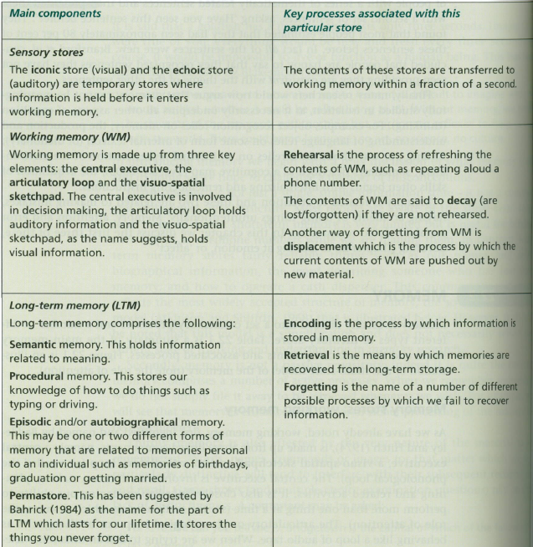
A Summary of Structured Memory (by David Benyon)

Slide 49
Cognitive Processes - Learning

Slide 50
Cognitive Processes – Learning (2)
Learning
How do we
learn?
Approaches to
Learning
Techniques to
Guide Learning
Learning
Through Analogy
Learning Through
Trial-and-Error
Human Considerations

Slide 51
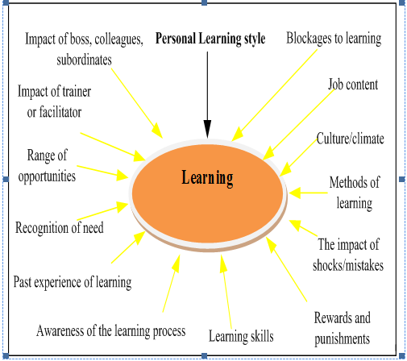
Factors that Influence Learning
Mulwa et al. (2010). Adaptive Educational Hypermedia Systems in Technology Enhanced Learning: A Literature Review

Slide 52
Cognitive Processes – Learning (3)
What is my LEARNING STYLE?
Visual learners learn through seeing…
Auditory learners learn through listening…
Kinesthetic learners learn through doing, moving and touching…
Human Considerations

Slide 53
Visual Learner (Let me see it!)
Prefer to see information such as pictures, diagrams, cartoons, demonstrations
Easily distracted in lectures with no visual aids
Overwhelmed with intense visuals accompanied by the lecture
Benefit from using charts, maps, notes and flash cards when studying

Slide 54
Auditory Learner (Let me hear it!)
Prefer to hear information spoken
Can absorb a lecture with little effort
May not need careful notes to learn
Often avoid eye contact in order to concentrate
May read aloud to themselves

Slide 55
Tactile Learner (Kinesthetic) (Let me Experience it!)
Prefer touch as their primary mode for taking information
They should write out important facts in traditional lecture situations
Create study sheets connected to vivid examples
Benefit by using manipulation (e.g. organising notes into a schema)

Slide 56
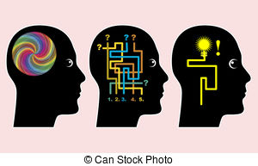
Cognitive Processes – Learning (4)
How do people learn?
Nobody really knows, but there are 6 main theories:
Behaviourism
Cognitivism
Humanist Theory -
Social Learning Theory
Social Constructivism
Multiple Intelligences
Brain-Based Learning
Human Considerations

Slide 57
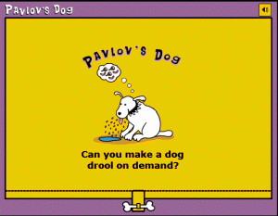
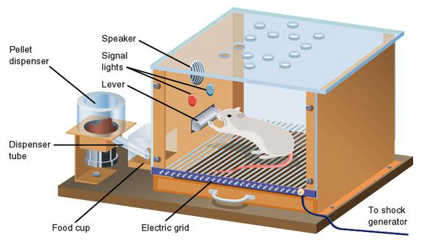
Cognitive Processes – Learning (5)
Do we learn like a Behaviourist?
Confined to observable and measurable behaviour
Human Considerations

Slide 58
Behaviourism Theory
Learning is defined by the outward expression of new behaviours.
It focuses solely on observable behaviours.
It describes a biological basis for learning.
Learning is context-independent.
Human Considerations

Slide 59
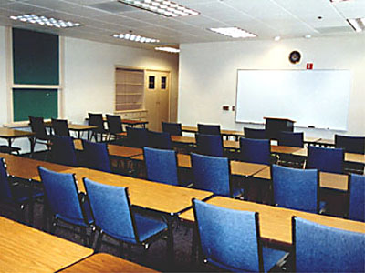
Behaviourism in the Classroom
Rewards and punishments.
Responsibility for student learning rests squarely with the teacher.
Lecture-based, highly structured.
Human Considerations

Slide 60
Cognitive Processes – Learning (6)
Do we learn through Cognitivism?
What have we learned about cognitive processes?
Knowledge is stored cognitively as symbols.
Learning is the process of connecting symbols in a meaningful and memorable way.
Studies have focused on the mental processes that facilitate symbol connection…
…and grew in response to Behaviourism.
Human Considerations

Slide 61
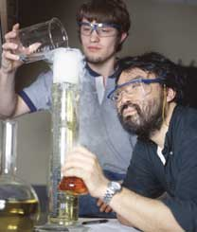
Cognitivism in the Classroom
Often has inquiry-oriented projects.
There ought to be opportunities for the testing of hypotheses.
Curiosity is encouraged.
Human Considerations

Slide 62
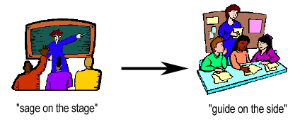
Cognitive Processes – Learning (7)
Do we learn like a Constructivist?
Learners construct knowledge for themselves.
Learning is an active process.
Learning is a social activity.
Human Considerations

Slide 63
Cognitive Processes – Learning (8)
Do we learn like a Humanist?
‘You decide hpw you learn…!’
All students are intrinsically motivated to self-actualise or learn.
Learning is dependent upon meeting a hierarchy of needs (physiological, psychological and intellectual).
Learning should be reinforced.
Human Considerations

Slide 64
Cognitive Processes – Learning (9)
There are two main approaches that users use when learning new computer systems:
Learning through
Trial and
Error
Analogy
Human Considerations

Slide 65
Cognitive Processes – Learning (10)
Learning through analogy
Two theories are used in this approach (as introduced in “Cognitive Frameworks”):
Mental Models
Metaphors
Human Considerations

Slide 66
Recap… mental models
How do we understand the way how the world works around us?
Memory (past experience)
Expectation of behaviour of things
We have certain understanding of the world’s mechanics:
How do objects in the world react?
What is the relationship among them?
When throwing a ball to a friend:
How fast should I throw an object?
How do they know where to stand to catch?
Human Considerations

Slide 67
Recap… mental models (2)
A cognitive structure
“It’s in one’s head.”
The models describe how certain aspects of the world work
How objects of certain class mutually interact with objects of different class
How objects change their properties during an interaction
Each person has their own unique mental model of the world.
Human Considerations

Slide 68
Cognitive Processes – Learning (11)
Learning through trial and error
We always make mistakes learning a new skill.
Feedback from making errors can help us to learn and understand an activity.
Users of computer systems are often scared of making errors.
Anticipation of errors may hinder a user’s interaction with a system.
The process must provide safeguards, but also good feedback.
Human Considerations

Slide 69
Cognitive Processes – Learning (12)
There are two categories of errors:
Mistakes –
Incorrect mental model, incorrect action is taken based on an incorrect decision
Occur intentionally (i.e. The intentional behaviour is not recognised as a mistake until later)
Slips –
Unintentional errors
Skilled behaviour
Human Considerations

Slide 70
description
correct action,
wrong object
capture
frequently done
activity captures
the action
Slips
mode
thinking in one state,
but actually being in
another
data-driven
unconscious
processing of
external data
loss-of-activation
forgetting something
mid-flow of activity
associative-activation
internal thoughts
interfere with a current
task
Human Considerations

Slide 71
Cognitive Processes – Learning (13)
Error Prevention Guidelines
Use good coding techniques (colour, style).
Maximise recognition, minimise recall.
Minimise the need for typing.
Allow reconsideration of action by the user (e.g., removing a file from trash).
Human Considerations

Slide 72
Cognitive Processes – Learning (13)
Error Prevention Guidelines continued
Provide an appropriate type of response -
Prevent user from continuing
Warn user an unusual situation is occurring
Self-correct - spell-check correction
System opens dialog with user - go into debugger on run-time crash
Human Considerations

Slide 73
Cognitive Processes – Learning (14)
Error Prevention Guidelines
Provide an undo function
Provide a cancel function from operations in progress
Require confirmation for drastic, destructive commands
Provide reasonableness checks on input data
Provide some intelligence
Guess what the user wanted to do when making error
Provide quick access to context-sensitive help
Human Considerations

Slide 74

Three main commandments for aiding user learning
Facilitated
by
Use
Allow
for
Metaphors
Errors
Human Considerations

Slide 75
Cognitive Processes
INTERACTIVE PROCESSES
Attention
Attention is aided
by perception
Attention enhances
learning
Perception
Learning
Perception requires
memory
Memory
Learning enhances
memory
Cognitive Process Guidelines
Human Considerations

Slide 76
Summary of the Lecture
Perception
Attention
Basic forms of attention
Multi-tasking and interruptions
Automatic processing
Techniques to guide attention
Memory
Categories of memory
Levels of Processing Theory
Recognition vs. Recall
Techniques to guide memory
Learning
Learning theories, learning types

Slide 77
References
Norman, D. (1990) The Design of Everyday Things
Preece, J. et al. (2002) Interaction Design
Shneiderman, B. & Plaisant, C. (2005) Designing the User Interface
Benyon, D. et al (2005) Designing Interactive Systems
Miller, G. (1956) The Magical Number Seven, Plus or Minus Two: Some Limits on Our Capacity for Processing Information
Mulwa, C., Lawless, S., Sharp, M., Arnedillo-Sanchez, I., & Wade, V. (2010, October). Adaptive educational hypermedia systems in technology enhanced learning: a literature review. In Proceedings of the 2010 ACM conference on Information technology education (pp. 73-84). ACM.
Tullis, T. (1984) A Computer-Based Tool for Evaluating Alphanumeric Displays
FAA (..) FAA Human Factors
http://www.ted.com/index.php/talks/view/id/7 (video) or (same):
http://www.ted.com/talks/david_pogue_says_simplicity_sells
References

